Slide 1


Reducing Shock Interactions in a High Pressure Turbine via 3D Aerodynamic Shaping
Braden Hancock
Brigham Young University
B.S. Mechanical Engineering
Graduation 2014
Mentor: Dr. John Clark, AIAA “Engineer of the Year” 2012

Slide 2
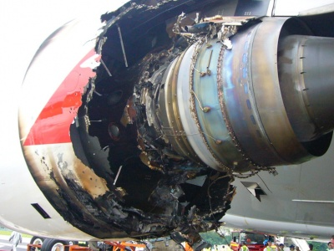
Motivation
The result of High Cycle Fatigue (HCF) failure in a gas turbine engine
Failed engine of an Airbus A380-800
As shown by NY Times , 4 Nov 2010

Slide 3
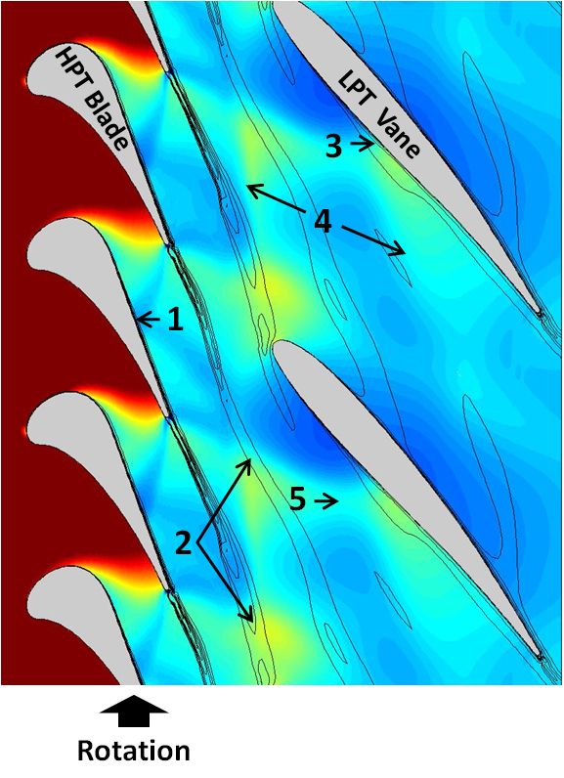
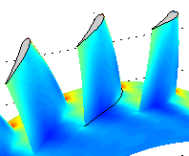
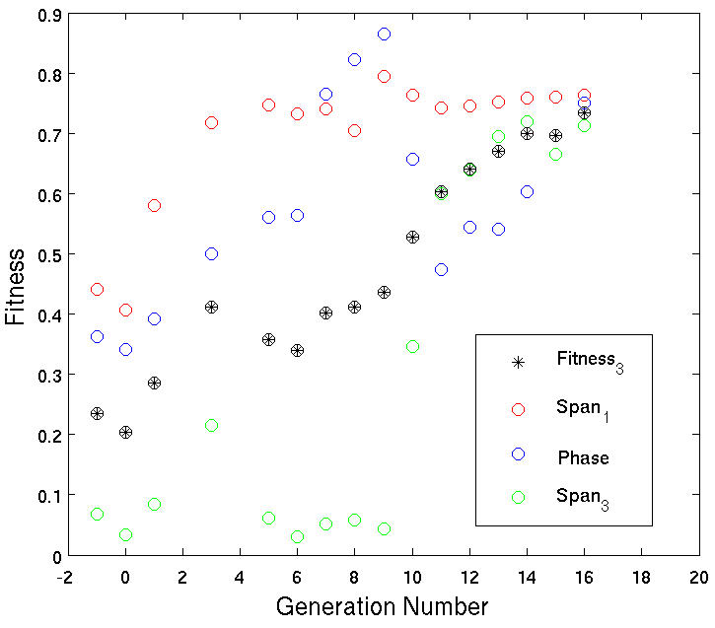
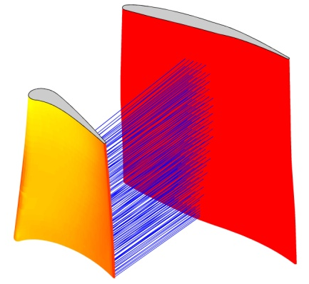
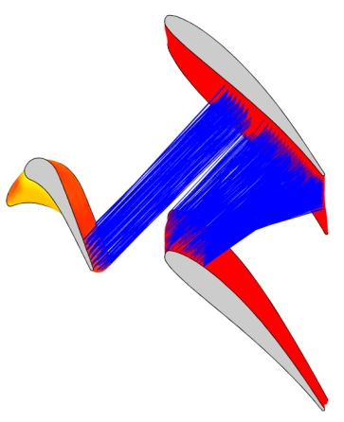
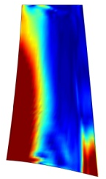
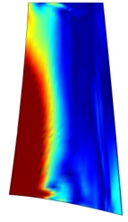
Outline
Causes of HCF Failure
Method of 3D Aerodynamic Shaping
Experimental Results - Benchmark
Method of Surface Normal Projections (SNP)
Experimental Results - Comparison
Conclusions

Slide 4
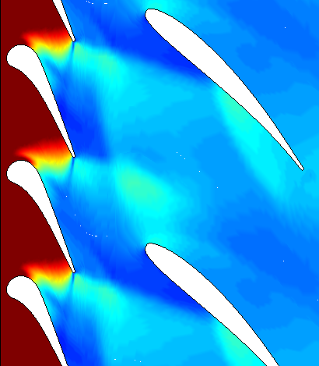
Shock Reflections
reflection surface
Unsteady interactions in a high pressure contra-rotating turbine:
1) Unsteady shock/boundary-layer interaction
2) Shock/shear-layer interactions
3) Moving shock/boundary-layer interaction
4) Reflected shocks
5) Shock/shock interaction
vane
blade
oblique shock
blade
“A decrease in the level of empiricism in [unsteady flows] would be of significant value in the engine development process…”
-Greitzer, E. M., Tan, C. S., Wisler, D. C., Adamczyk, J. J., and Strazisar, A. J., 1994. “Unsteady Flows in Turbomachines: Where’s the Beef?,” Unsteady Flows in Aeropropulsion, ASME AD-Vol. 40, pp. 1-11.
vane
blade
reflected shock
location
Rotation

Slide 5
Shock Reflection Movement
Direction of Travel
Velocity
of Medium
Velocity
of Medium
Shock Wave
Reflected Shock Wave

Slide 6
Shock Reflection Movement
Direction of Travel
Velocity
Velocity
Shock Wave
Reflected Shock Wave

Slide 7
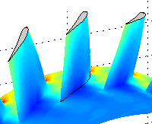

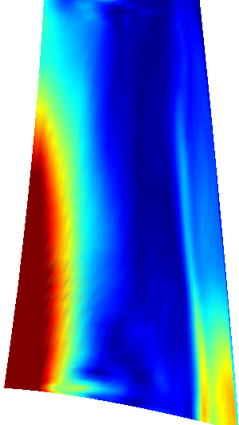
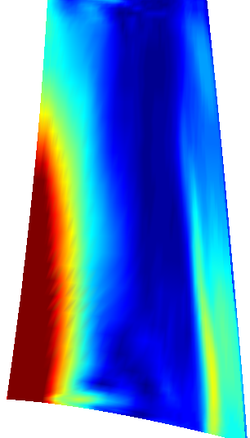
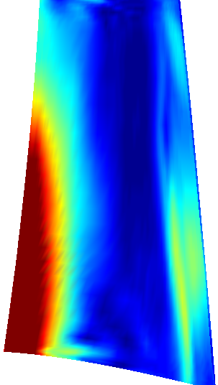
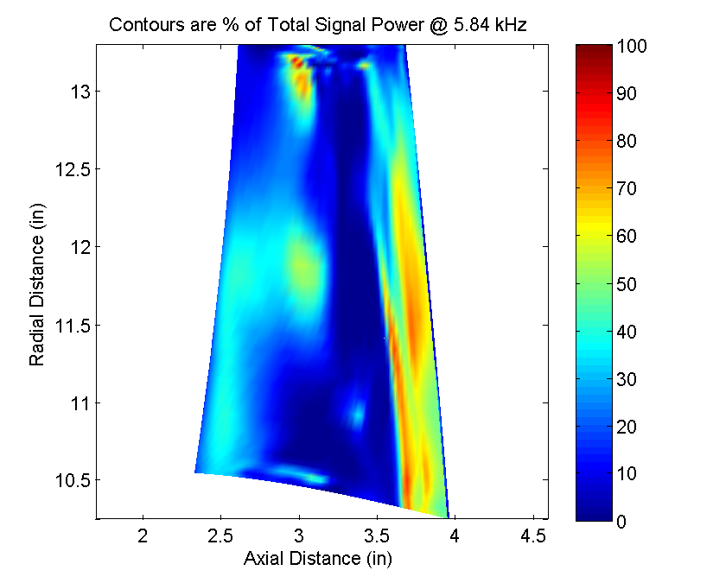
3D Aerodynamic Shaping
Upstream vanes
Tip
Root
Bowed
Baseline
Reverse-Bowed
5
100 DFT mag. / Pt _{inlet}
0
Resulting pressure distributions on upstream blades

Slide 8
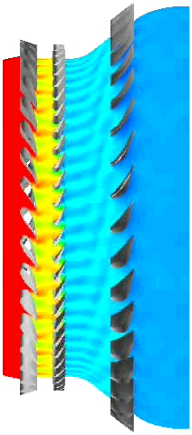
Engine Orientation
Radial
Axial
Circumferential

Slide 9
3D Aerodynamic Shaping
Upstream vanes
Tip
Root
Bowed
Baseline
Reverse-Bowed
5
100 DFT mag. / Pt _{inlet}
0
Resulting pressure distributions on upstream blades

Slide 10

Genetic Algorithm
Initial Generation
Many chromosomes together describe an individual
.01742
… 0 1 7 4 2 3 5 0 8 1 9 2 6 4 5 …
Calculate Fitness
.92645
Selection
Two successful individuals mate to form new individuals
Mating
…017423508192645…
…017423508187324…
…016354071287324…
…016354071292645…
Mutation
Random mutation occurs occasionally
New Generation
…017423508192645…
…017473508192645…

Slide 11
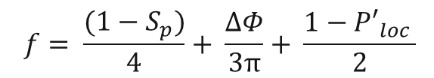
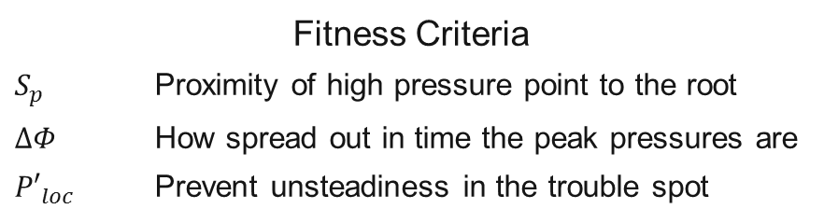
3D Unsteady RANS Analysis
Fitness Criteria
$S_{p}$ Proximity of high pressure point to the root
$ΔΦ$ How spread out in time the peak pressures are
${P′}_{loc}$ Prevent unsteadiness in the trouble spot
$$f= \frac{(1−S_{p})}{4}+ \frac{ΔΦ}{3π}+ \frac{1−{P′}_{loc} }{2}$$
Genetic Algorithm (GA) Data
Number of Processors | 96
Generations | 16
Population size | 24
Hours of Runtime per Generation | 23.3
fitness
S_{P}
ΔΦ
P ′_{loc}

Slide 12
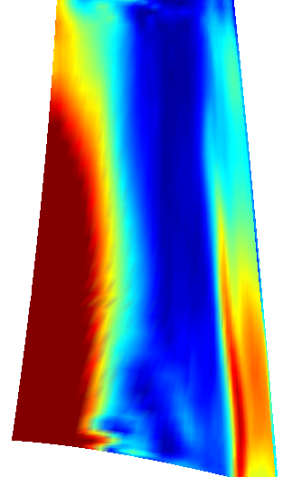
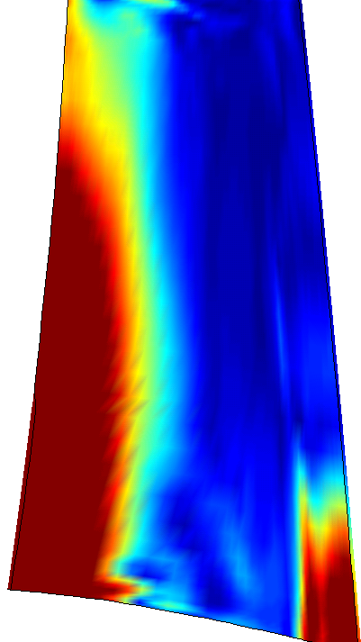
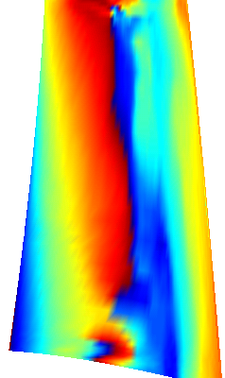
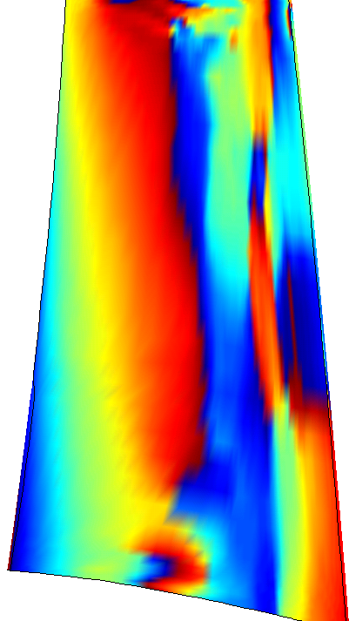
Results of CFD Analysis
The distribution of:
a) total static pressure in terms of DFT magnitude
b) phase angle in degrees
on the blade suction side due to the baseline and optimized vanes:
a)
b)
5
180⁰
100 DFT mag. / Pt _{inlet}
100 DFT mag. / Pt _{inlet} , Phase Angle
0
-180⁰
Baseline
Bowed
Baseline
Bowed
Pressure
Phase Angle

Slide 13
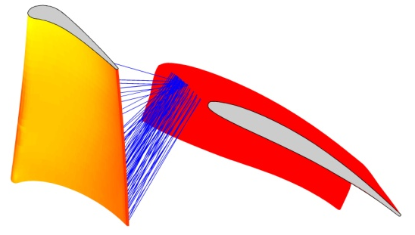
Surface Normal Projections (SNP)
Standard Vane
Bowed Vane
Shock reflections plotted from the pressure side of a downstream vane to the suction side of an upstream blade

Slide 14
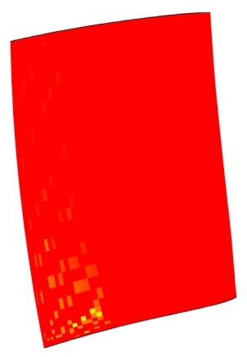
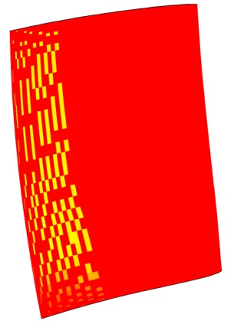
Additional Considerations
tip
root
Standard
Bowed
The relative magnitudes of shock reflections on an upstream blade from a downstream vane
An example of the blockage that can occur due to the presence of an adjacent vane in the line of sight of the projecting surface.

Slide 15


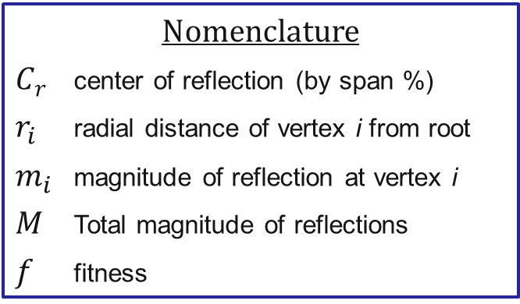
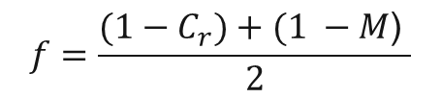
Genetic Algorithm Optimization
Genetic Algorithm Comparison
 | CFD Approach | SNP Approach
Population size | 24 | 48
Generations | 16 | 80
Pitch Change Range | 0 - 20 | (-100) - 100
Computation Time per Individual | 84000 s | 6 s
Equations
$$C_{r}= \frac{∑r_{i}m_{i}}{∑m_{i}}$$
(1)
$$M=∑m_{i}$$
(2)
$$f=\frac{{(1−C}_{r})+(1 −M\text{) }}{2}$$
(3)
Nomenclature
$C_{r}$ center of reflection (by span %)
$r_{i}$ radial distance of vertex i from root
$m_{i}$ magnitude of reflection at vertex i
$M$ Total magnitude of reflections
$f$ fitness

Slide 16
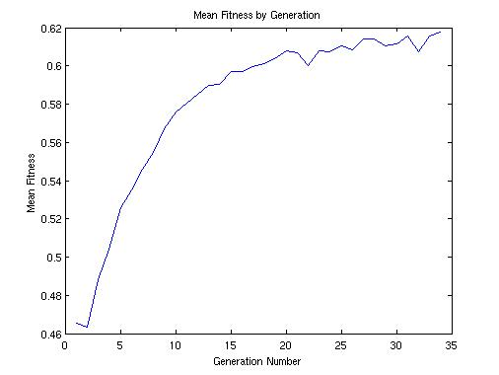
Fitness Trends

Slide 17
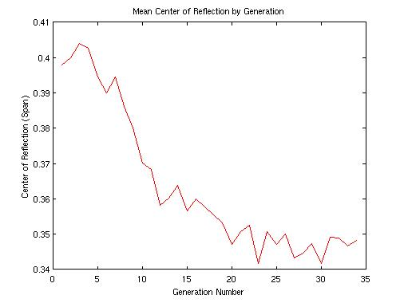
Center of Reflection

Slide 18
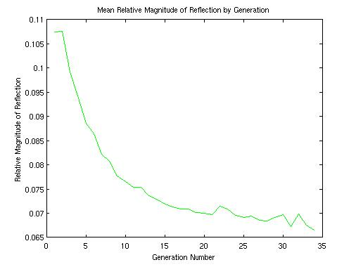
Relative Magnitude of Reflection

Slide 19
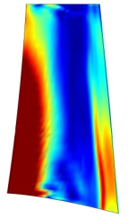
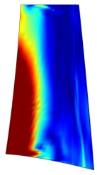

Results of Projection Calculations
total sum of reflections
M = 1.00
M $≈$ 1.00
M = 0.01
100% span
48% span
29% span
6% span
0% span
Baseline
CFD Optimal
Normal Projection Optimal
0
5
100 DFT mag. / Pt _{inlet}

Slide 20
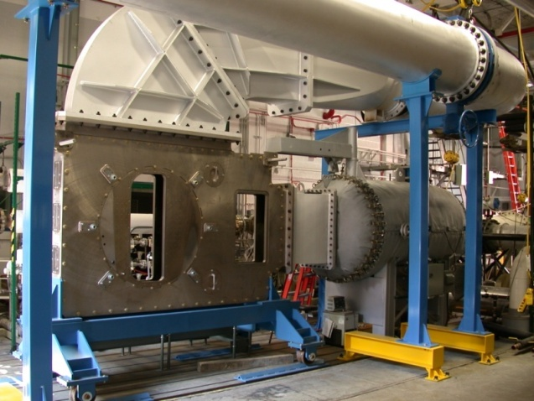
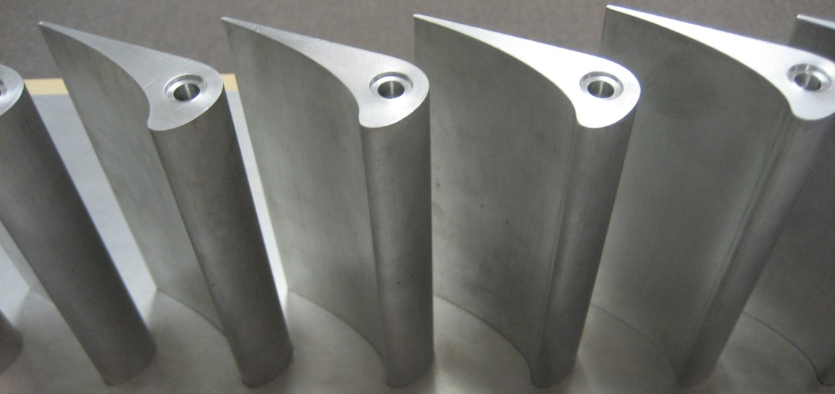
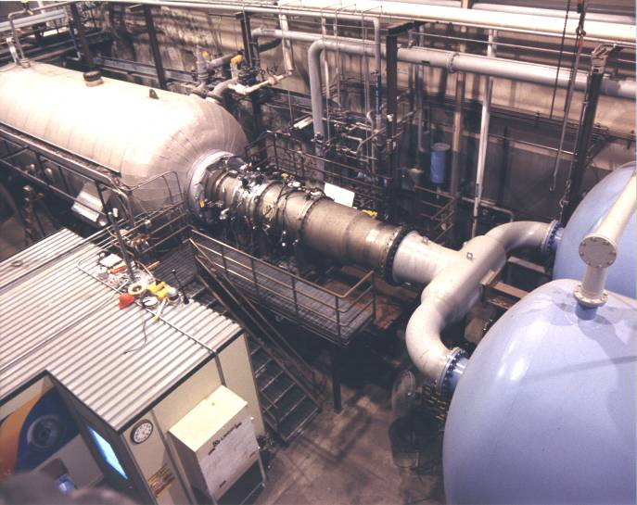
What’s Next?
New transonic cascade facility is on-line (2D)
Annular-Cascade, HPT Stage, and Stage +1/2 Testing in the Turbine Research Facility (3D)

Slide 21
Conclusions
1) Vane bowing has been shown to be a viable method for redirecting shock waves to regions of the blade where their detrimental effects will be mitigated.
2) Surface normal projections from downstream vanes may be used to estimate the results of shock reflections on upstream blades.
Reduction of pressure fluctuations by 2 orders of magnitude
Translation of center of reflection by 42% span
Baseline
Normal Projection
48% span
6% span
3) Including the SNP method in the design of turbine airfoils holds significant advantages over an approach consisting exclusively of CFD simulations.
Reduction of computational time per airfoil by 4 orders of magnitude

